Slide 1
Unit 1 chapter2
Boolean Algebra
Gates and Circuits

Slide 2
Chapter Goals
Describe gates and circuits using:
Boolean expressions
Truth Tables
Logic Diagrams

Slide 3
Intro
Transistor A device that can be used to make gates.
Gate A device that performs a basic operation on bit(s).
Circuits Gates combined to perform more complicated tasks.

Slide 4
GATES
Boolean expressions A mathematical notation for expressing TRUE/FALSE logic.
Example: F = AB + C

Slide 5
GATES
Logic diagram A graphical representation of a circuit .Each type of gate is represented by a specific graphical symbol.
Truth table A table showing all possible input values and the associated output values.

Slide 6
LOGIC GATES
Binary Logic Gates are the basic building blocks for all digital circuits.
A Circuit with one or more input signals but only one output signal.
Gates are Digital (2 - state) circuits because the input and output signals are either low or high voltages.

Slide 7
LOGIC GATES
Gates are often called logic circuits because they can be analyzed with Boolean algebra.
The table which lists the corresponding output with the given input is called Truth Table.
Binary 0 stands for low voltage and
binary 1 for high voltage.

Slide 8
LOGIC GATES
Basic Gates---AND, OR, NOT.
Universal Gates---NAND, NOR.
Special Gates---XOR, XNOR

Slide 9
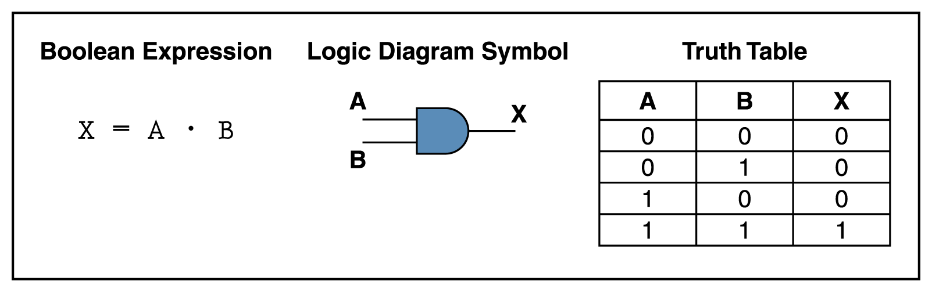
AND GATE
The AND Gate has 2 or more input signals but only one output signal.
The unique output of an AND gate is a HIGH output only when all inputs are HIGH.

Slide 10
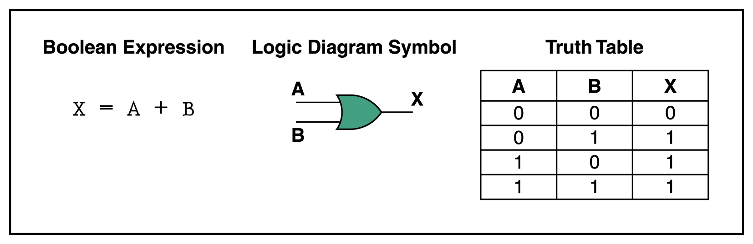
OR Gate
The unique output of an OR gate is LOW output only when all inputs are LOW.

Slide 11
INVERTER (NOT GATE)
An Inverter is a Gate with only one input signal and one output signal, the output state is always the opposite of the input state.
An inverter is also called a NOT Gate, because the output is not the same as the input. The output is sometimes called the Complement (opposite) of the input.

Slide 12
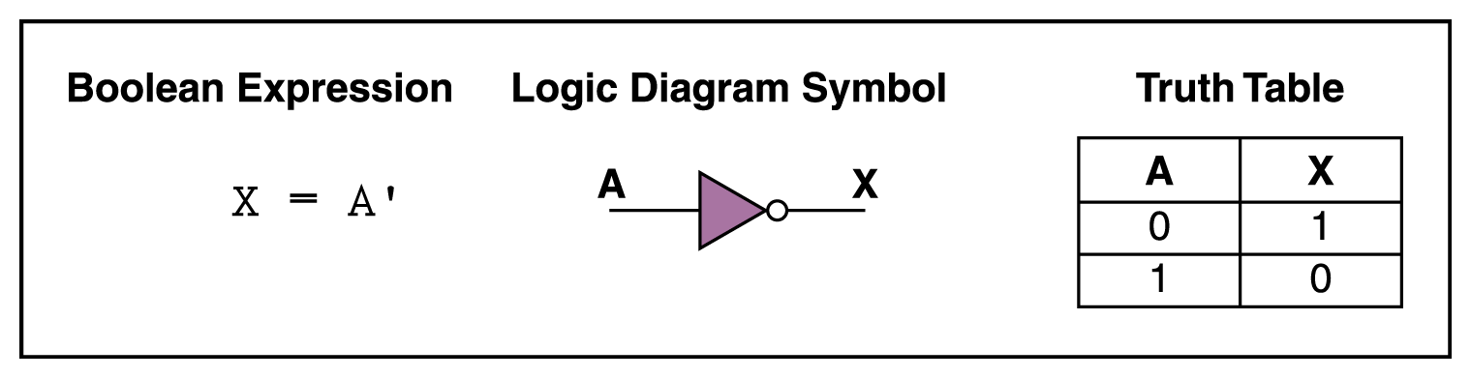
NOT Gate

Slide 13
Buffer
The triangle symbol by itself designates a buffer circuit.
A buffer produces the transfer function but does not produce any particular logic operation.
Since the binary value of the output is equal to the binary value of the input.

Slide 14
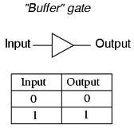
Buffer
Expression is Y=A. (Y is output, A is input)

Slide 15
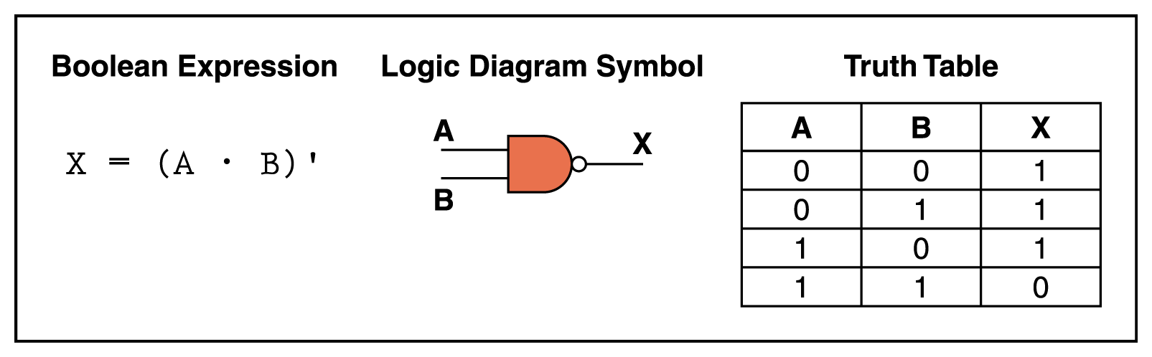
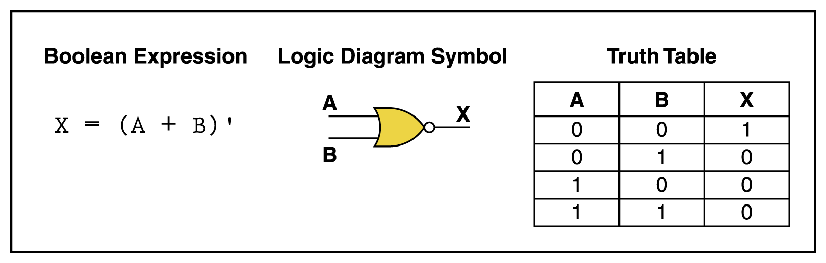
NAND and NOR Gates
The NAND and NOR gates are essentially the opposite of the AND and OR gates, respectively
NAND gate:
NOR gate:

Slide 16
NAND GATE (NOT-AND)
The NAND gate has two or more input signals but only one output signal.
All input signals must be high to get a low output.
The figure shows the logical structure of a NAND gate, an AND gate followed by an inverter.

Slide 17
NAND GATE (NOT-AND)
Therefore, the final output is NOT the AND of the inputs. Originally called a NOT-AND gate, the circuit is now referred to as a NAND gate.
In the following figure observe that the inverter signal has been deleted and the bubble moved to the AND gate output.
If one or more inputs are low, the result of AND ing is low. Therefore the final inverted output is high.

Slide 18
NOR (NOT-OR)
The NOR gate has two or more input signals but only one output signal.
All inputs must be low to get a high output.
The following figure shows the logic structure of a NOR gate, which is an OR gate followed by an inverter.

Slide 19
NOR (NOT-OR)
Therefore the final output is NOT the OR of the inputs.
Originally called a NOT- OR gate, the circuit is now referred to as a NOR gate.
In the following figure notice that the inverter triangle has been deleted and the small circle or bubble moved to the OR-gate output.
The bubble is a reminder of the inversion that follows the “OR” ing.

Slide 20
EXCLUSIVE OR GATE (XOR)
An OR gate recognizes words with one or more 1’s.
The Exclusive-OR gate is different; it recognizes only words that have an odd number of 1’s.
If an even number of HIGH inputs to the XOR gate are present, the output will be LOW.
Referred as “odd but not even gate”.
Expression y=AB+AB

Slide 21
Truth Table, Logic Symbol, Expression

Slide 22
EXCLUSIVE NOR GATE (XNOR)
The Exclusive NOR gate, abbreviated XNOR, is logically equivalent to an XOR gate followed by an inverter.
Because of the inversion on the output side, the truth table of an XNOR gate is the complement of an XOR truth table.
Referred as “even but not odd gate”.
Expression y=AB+AB

Slide 23
Truth Table, Logic Symbol, Expression

Slide 24
EXCLUSIVE NOR GATE (XNOR)
As shown in the table, “the unique output of the XNOR is LOW(0) only when an odd number of inputs are HIGH(1) which is the opposite from the XOR gate”.

Slide 25
A | B | XOR | XNOR
0 | 0 | 0 | 1
0 | 1 | 1 | 0
1 | 0 | 1 | 0
1 | 1 | 0 | 1
INPUTS |  | OUTPUT

Slide 26
NAND GATE as an Universal Gate
NAND gate is widely used than other type of gates. NAND gate can be substituted for other gates.
Since NAND gate is used to make other type of gates it is called as “Universal Gate”.
Here is the table for substituting NAND gates.

Slide 28

Universal properties of NOR gate

Slide 29


NOR gate as NOT gate
(Before Bubble)
X
OR gate using NOR gates:
X
Y
NOR Gate
“Inverter”

Slide 30
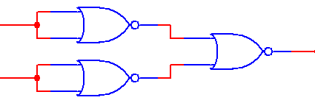
AND gate using NOR gates
X
Y
“Inverters”
NOR Gate

Slide 31





NAND gate
A
B
NAND gate using NOR gates

Slide 32

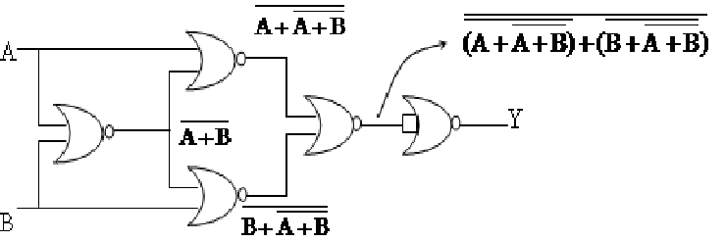
X-OR gate.
X-OR gate using NOR gates

Slide 33





X-NOR gate
X-NOR gate using NOR gates
A
B

Slide 34
Boolean Functions
Boolean Expression
Example: F = x + y’ z
Truth Table
All possible combinations of input variables
Logic Circuit
x | y | z | F
0 | 0 | 0 | 0
0 | 0 | 1 | 1
0 | 1 | 0 | 0
0 | 1 | 1 | 0
1 | 0 | 0 | 1
1 | 0 | 1 | 1
1 | 1 | 0 | 1
1 | 1 | 1 | 1

Slide 35
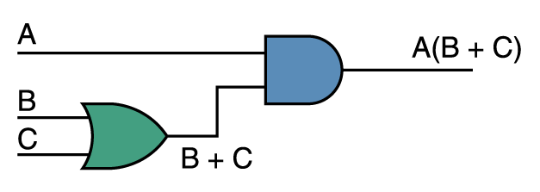
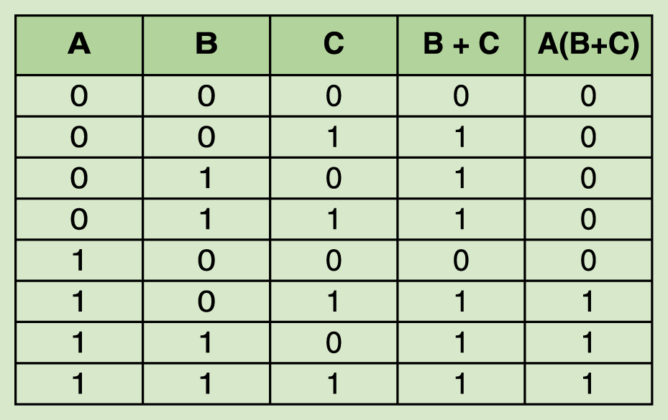
Combinational Circuits
Consider the following Boolean expression A(B + C)

Slide 36
SOP & POS
Sum of products(SOP): It is a Boolean expression where different AND terms are ORed. It is denoted by SOP
e.g. xyz+x’y’z+x’y’z’
xy + x’y’
xyz + y + x

Slide 37
Product of sums (POS): It is a Boolean expression where different OR terms are ANDed. It is denoted by POS
e.g. (y+x’) (x+z) (y+z)
(y+x’+z’) (x+z+y) (x+z+y’)

Slide 38
Postulates & Theorems of Boolean Algebra
x+0=x x.1=x
x+x’=1 x.x’=0
x+x=x x.x=x
x+1=1 x.0=0
(x’)’=x Involution Law

Slide 39
Postulates & Theorems of Boolean Algebra
x+y=y+x x.y=y.x Commutative
x+(y+z)=(x+y)+z ,x(yz)=(xy)z Associative
x(y+z)=xy+xz, x+yz=(x+y)(x+z) Distributive
x+xy=x , x(x+y)=x Absorption
(x+y)’=x’y’, (xy)’=x’+y’ DeMorgans

Slide 40
DeMorgan’s Theorem
1. (A+B)’= A’.B’
2. (AB)’ = A’+ B’
Compliment of Sum is equal to product of their compliments.
Compliment of product is equal to sum of their compliments.

Slide 41
DeMorgan’s Theorem
This theorem is widely used in Boolean logic design. Stated in words it is: To "invert" (negate) a Boolean expression, replace the AND operator with the OR operator (or vice versa) and invert the individual terms.
The theorem holds for any number of terms,
(A+B+C+……+X)' = A'• B'• C'………….X‘
(A•B•C•....•X)' = A' + B' + C' + ......+ X'

Slide 42
Truth Table to Verify DeMorgan’s
X + Y = X · Y
X · Y = X + Y
X | Y | X·Y | X+Y | X | Y | X+Y | X · Y | X·Y | X+Y
0 | 0 | 0 | 0 | 1 | 1 | 1 | 1 | 1 | 1
0 | 1 | 0 | 1 | 1 | 0 | 0 | 0 | 1 | 1
1 | 0 | 0 | 1 | 0 | 1 | 0 | 0 | 1 | 1
1 | 1 | 1 | 1 | 0 | 0 | 0 | 0 | 0 | 0
Generalized DeMorgan’s Theorem:
X₁ + X₂ + … + X_{n} = X₁ · X₂ · … · X_{n}
X₁ · X₂ · … · X_{n} = X₁ + X₂ + … + X_{n}

Slide 43
Adders
At the digital logic level, addition is performed in binary
Addition operations are carried out by special circuits called, appropriately, adders

Slide 44
A Half Adder
Recall that 1 PLUS 1 = 10 in base two
In other words: 0 with a carry of 1
Inputs |  | Outputs
A | B | Carry | Sum
0 | 0 | 0 | 0
0 | 1 | 0 | 1
1 | 0 | 0 | 1
1 | 1 | 1 | 0

Slide 45
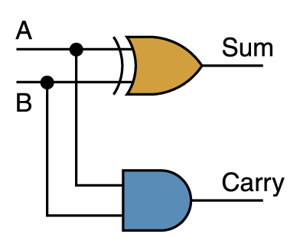
Half Adder Circuit
Two Boolean expressions:
sum = A ⊕ B
carry = AB
Page 103

Slide 46
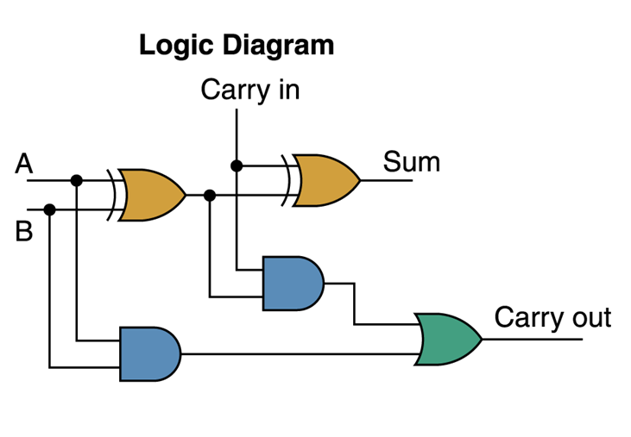
A Full Adder
A circuit called a full adder takes the carry-in value into account
Inputs |  |  | Outputs
A | B | Carry In | Carry-Out | Sum
0 | 0 | 0 | 0 | 0
0 | 0 | 1 | 0 | 1
0 | 1 | 0 | 0 | 1
0 | 1 | 1 | 1 | 0
1 | 0 | 0 | 0 | 1
1 | 0 | 1 | 1 | 0
1 | 1 | 0 | 1 | 0
1 | 1 | 1 | 1 | 1

